Slide 1


The Slovak Republic
Economic Division
Taipei Representative Office in Bratislava
2013

Slide 2
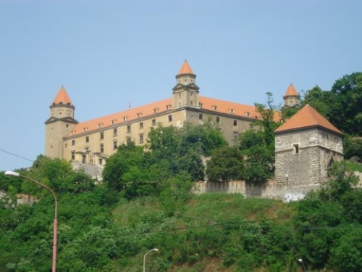
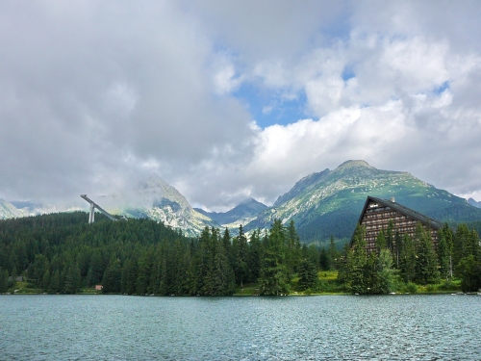
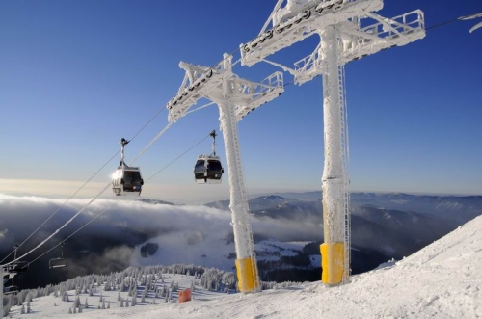
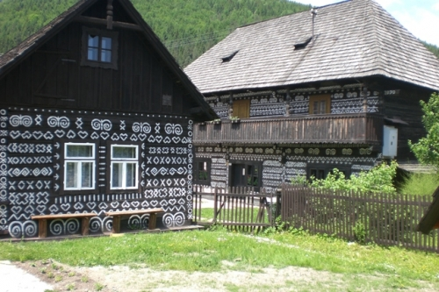
CONTENT
Slovakia Facts & General Information
Slovakia's Economy
Slovakia´s Bilateral Trade & Investment Relations
IV. Taipei Representative Office in Bratislava

Slide 3
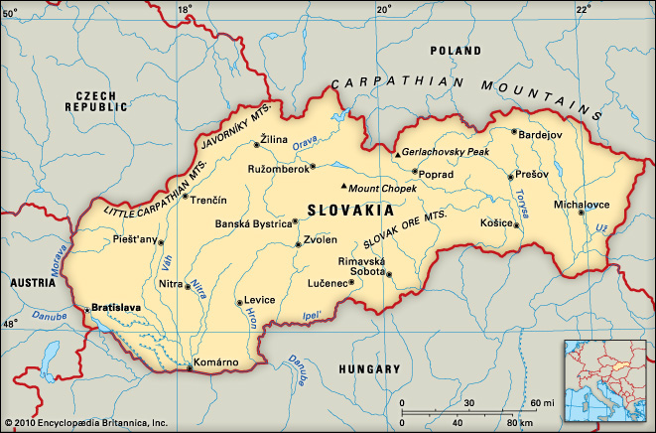
Slovakia in Central Europe

Slide 4


I. Slovakia Facts & General Information

Slide 5
I. Slovakia Facts & General Information
Official name: | Slovak Republic (orig. Slovenská republika) (SR)
Establishment date: | 1st January 1993
Capital city: | Bratislava
Establishment: | Republic
Political system: | Parliamentary Democracy (150-seat unicameral, delegates are elected for 4-year term)
President: | Ivan Gašparovič, elected for 5-year term (assumed office in 2004, 2nd term)
Prime Minister | Robert Fico, political party SMER – social democracy (in office since April 2012)
Location: | Central Europe
Language: | Slovak
Currency: | EURO (since 1st Jan 2009)
Population: | 5 447 502 inhabitants
Area: | 49 035 sq km

Slide 6
I. Slovakia Facts & General Information
Bordering Countries (5): Czech Republic, Poland, Ukraine, Hungary and Austria
Population density: 189 persons/sq km. Slovak population distribution is quite uneven (mountains, lowlands).
Nationality:
  Slovak nationality represent 85.5% of the whole population
  Hungarian nationality: approx. 520,000 citizens (9.7% of the Slovak population)
  Roma nationality: approx. 90,000 citizens (1.7% of Slovaks)
  Others: Czechs (0.8%), Ruthenians and Ukrainians mostly in eastern Slovak regions

Slide 7
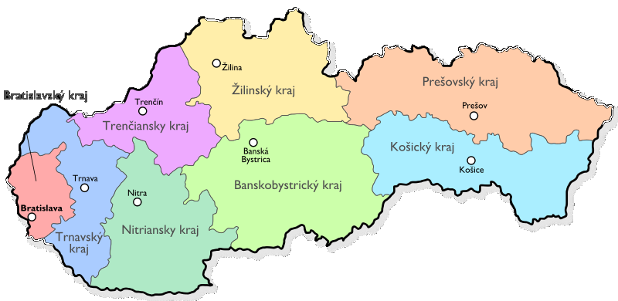
I. Slovakia Facts & General Information
Region | Area/ km² | Inhabitants | Density/km² | Districts
Bratislava Region | 2,052.6 | 603,699 | 249 | 8
Trnava Region | 4,174.2 | 554,172 | 133 | 7
Trenčín Region | 4,501.9 | 600,386 | 133 | 9
Nitra Region | 6,343.4 | 708,498 | 112 | 7
Žilina Region | 6,808.4 | 694,763 | 102 | 11
Banská Bystrica Region | 9,454.8 | 657,119 | 70 | 13
Prešov Region | 8,974.5 | 798,596 | 89 | 13
Košice Region | 6,751.9 | 771,947 | 114 | 11
Source: slovakiasite.com

Slide 8
I. Slovakia Facts & General Information
The largest cities of Slovakia
    Bratislava - 428,672 inhabitants
    Kosice - 240,915 inhabitants
    Presov - 92,687 inhabitants
    Nitra - 87,357 inhabitants
    Zilina - 86,685 inhabitants
    Banska Bystrica - 84,919 inhabitants
    Trnava - 70,191 inhabitants
    Martin - 60,772 inhabitants
    Trencin - 58,872 inhabitants
    Poprad - 55,037 inhabitants
Source: slovakiasite.com

Slide 9
I. Slovakia Facts & General Information
Membership in international organisations
NATO (29 March 2004)
European Union (1 May 2004)
United Nations (1993) Schengen Agreement (21 December 2007)
Others (WHO, WTO, IMF, OECD, UNESCO..)

Slide 10
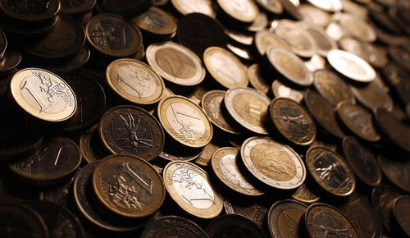
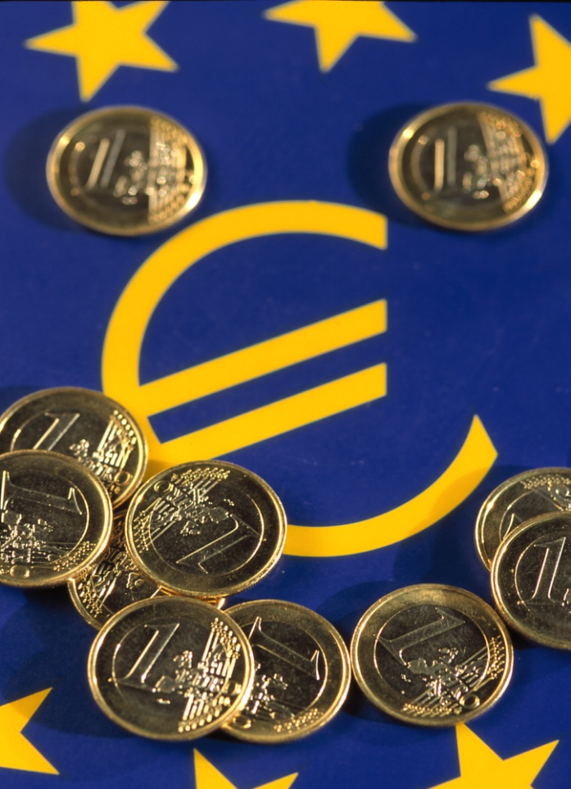
II. Slovakia's Economy

Slide 11
II. Slovakia's Economy
2.1 Key Economic Indicators (2012)
GDP I-IIIQ/2012 | € 126 bn
GDP growth (2012 Q3 in %) | 2.1
GDP per capita (PPP) – 2012 | € 13,100
Unemployment rate (%) | 14,4
Gross foreign debt (bn. USD) | 66.3
Annual CPI inflation rate (%) | 2.4
State budget balance (mil. EUR) | -3,811
Deficit ratio (government deficit as % of GDP) | -5.3
Index of industry production (%) | 8.1
Indicator of economic sentiment (long-term average = 100) | 84.1
Pensions (average in EUR) | 376
Average monthly nominal wage (EUR) | 782
Minimum wage (EUR) | 337.7
 | Source: portal.statistics.sk

Slide 12
II. Slovakia's Economy
2.2 Share of Sectors on national GDP (2011)
Slovakia GDP I-IIIQ/2012: € 126 bn
Industry | 29.50%
Sales, transportation, accommodation & restaurant services | 16.40%
Public administration, defense, social insurance | 12.40%
Taxes | 9.40%
Construction | 8.50%
Administrative services, science & technical activities | 5.50%
Activities in the real estate sector | 5.30%
Infrastructure & Telecommunication | 4.20%
Financial & Insurance Services | 3.10%
Agriculture, Forestry & Fishery | 2.90%
Art, entertainment & recreational services | 2.80%
Source: portal.statistics.sk

Slide 13
II. Slovakia's Economy
2.3 Car Manufacturing
Vehicle production for 2012: 925 000 cars (increase of annual production by 45%)
Contribution to the total exports of Slovakia: 20%
Three automotive companies in Slovakia:
  VOLKSWAGEN (Bratislava, 1992)
  PSA Peugeot-Citroën (Trnava, 2003)
  Kia Motors (Žilina, 2004)
Company | Total sales 2011 | Production capacity | Export 2011
Volkswagen | €5.193bn | 400,000/year | 99%
Kia Motors Slovakia | €3.328bn | 300,000/year | 99%
PSA Slovakia | €1.642bn | 300,000/year | 99%

Slide 14
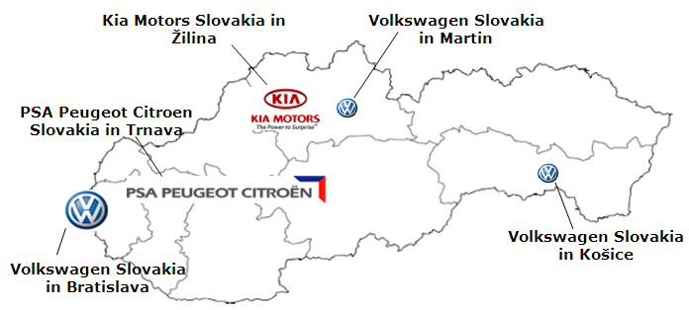
II. Slovakia's Economy
2.3 Car Manufacturing

Slide 15
II. Slovakia's Economy
2.4 Top 10 Companies in Slovakia 2011
 | COMPANY | SALES 2011 (€ bn) | SALES 2010 (€ bn) | Change 2011/2010 (%)
1 | Volkswagen Slovakia a.s., Bratislava | 5.20 | 4.00 | 28.60
2 | Slovnaft, a.s., Bratislava | 4.74 | 3.50 | 35.40
3 | Kia Motors Slovakia, s.r.o., Žilina | 3.33 | 2.88 | 15.20
4 | Samsung Electronics Slovakia, s.r.o., Galanta | 3.16 | 3.24 | -2.40
5 | Slovenské elektrárne, a.s., Bratislava | 2.84 | 2.14 | 32.70
6 | Slovenský plynárenský priemysel, a.s., Bratislava | 2.51 | 2.52 | -0.40
7 | U.S. Steel Košice, s.r.o., Košice | 2.43 | 2.46 | -1.30
8 | PCA Slovakia, s.r.o., Trnava | 1.64 | 1.65 | -0.70
9 | Tesco Stores SR, a.s., Bratislava | 1.31 | 1.17 | 11.90
10 | Foxconn Slovakia, s.r.o., Nitra | 1.04 | 1.42 | -26.90
Source: firmy.etrend.sk

Slide 16
II. Slovakia's Economy
2.5 Allocation of EU Structural Funds
Programming period 2004-2006: € 1.17 bn
Programming period 2007-2013: € 11.4 bn
Programming period 2014-2020: € 14.0 bn (planned)
Source: monitoringfondov.eu

Slide 17
II. Slovakia's Economy
2.5 Allocation of EU Structural Funds
Programming period 2007-2013 (in €)
Operation Programme (OP) | Fund | Financial allocation (€ ml.)
Regional OP | ERDF | 1,445
OP Environment | ERDF+CF | 1,820
 | ERDF | 251
 | CF | 1,569
OP Transport | ERDF+CF | 3,207
 | ERDF | 877
 | CF | 2,329
OP Informatization of Society | ERDF | 988
OP Research & Development |  | 1,209
OP Competition & Economic growth |  | 777
OP Health |  | 250
OP Technical support |  | 98
OP Bratislava region |  | 87
OP Employment | ESF | 882
OP Education | ESF | 618
Total |  | € 11.4 bn
Source: nsrr.sk

Slide 18
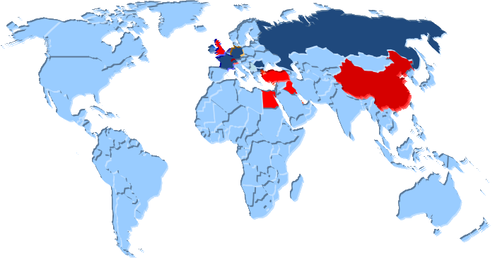
III. Slovakia´s Bilateral Trade & Investment Relations

Slide 19
III. Slovakia´s Bilateral Trade & Investment Relations
3.1 Slovakia´s balance of trade
Year | Import (ml. €) | Export (ml. €) | Balance of trade (ml. €)
2012 | 54 756,1 | 58 169,8 | 3 637
2011 | 53 966,1 | 56 407,9 | 2 441,9
2010 | 48 653,5 | 48 791,0 | 137,5
Source: portal.statistics.sk

Slide 20
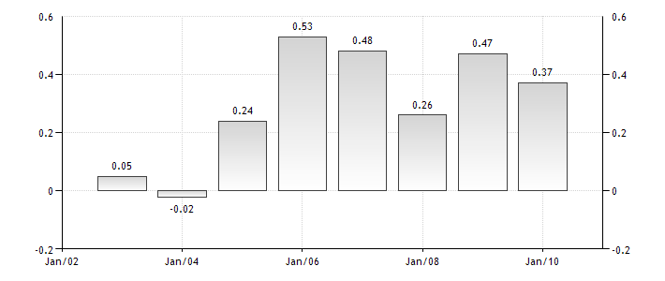
III. Slovakia´s Bilateral Trade & Investment Relations
3.2 Slovakia´s FDI
Foreign direct investment in Slovakia: 0.37% of GDP (last reported in 2010)

Slide 21
III. Slovakia´s Bilateral Trade & Investment Relations
3.3 Top 20 import countries
(January – October 2012)
 | Country of origin | Total Import (in mil. EUR) | Total Export (in mil. EUR) | Total trade | Balance of trade
1 | Germany | 8341.00 | 11 300 | 19641.00 | 2959.00
2 | Russian Federation | 4805.80 | 2 125.5 | 6931.30 | -2680.30
3 | Czech Republic | 4 789.1 | 7215.40 | 12004.50 | 2426.40
4 | Korea | 4491.40 | 80.30 | 4571.70 | -4411.00
5 | China | 2954.70 | 1241.50 | 4196.20 | -1713.20
6 | Poland | 1807.30 | 4152.50 | 5959.80 | 2345.20
7 | Hungary | 1785.20 | 3742.10 | 5527.30 | 1956.80
8 | Italy | 1493.40 | 2424.20 | 3917.60 | 930.70
9 | France | 1433.70 | 2863.70 | 4297.40 | 1430.00
10 | Austria | 1154.10 | 3523.00 | 4677.10 | 2368.90
11 | Japan | 824.90 | 86.60 | 911.50 | -738.30
12 | United Kingdom | 577.60 | 2076.40 | 2654.00 | 1498.80
13 | Spain | 539.60 | 919.80 | 1459.40 | 380.20
14 | Netherlands | 529.40 | 1188.60 | 1718.00 | 659.20
15 | Ukraine | 506.50 | 361.50 | 868.00 | -145.00
16 | Taiwan | 481.90 | 27.80 | 509.70 | -454.10
17 | United States | 441.90 | 1017.40 | 1459.30 | 575.50
18 | Belgium | 441.20 | 794.30 | 1235.50 | 353.10
19 | Romania | 434.90 | 920.90 | 1355.80 | 486.00
20 | Turkey | 318.50 | 705.50 | 1024.00 | 387.00
Source: portal.statistics.sk

Slide 22
III. Slovakia´s Bilateral Trade & Investment Relations
3.3 Top 20 export countries
(January – October 2012)
 | Country of destination | Total Export (in mil. EUR) | Total Import (in mil. EUR) | Total trade | Balance of trade
1 | Germany | 11300.10 | 8341.00 | 19641.00 | 2959.00
2 | Czech Republic | 7215.40 | 4 789.1 | 12004.50 | 2426.40
3 | Poland | 4152.50 | 1807.30 | 5959.80 | 2345.20
4 | Hungary | 3742.10 | 1785.20 | 5527.30 | 1956.80
5 | Austria | 3523.00 | 1154.10 | 4677.10 | 2368.90
6 | France | 2863.70 | 1433.70 | 4297.40 | 1430.00
7 | Italy | 2424.20 | 1493.40 | 3917.60 | 930.70
8 | Russian Federation | 2125.50 | 4805.80 | 3917.60 | -2680.30
9 | United Kingdom | 2076.40 | 577.60 | 6931.30 | 1498.80
10 | China | 1241.50 | 2954.70 | 4196.20 | -1713.20
11 | Netherlands | 1188.60 | 529.40 | 1718.00 | 659.20
12 | United States | 1017.40 | 441.90 | 1459.30 | 575.50
13 | Romania | 920.90 | 434.90 | 1355.80 | 486.00
14 | Spain | 919.80 | 539.60 | 1459.40 | 380.20
15 | Belgium | 794.30 | 441.20 | 1235.50 | 353.10
16 | Sweden | 778.60 | 214.90 | 993.50 | 563.70
17 | Turkey | 705.50 | 318.50 | 1024.00 | 387.00
18 | Switzerland | 684.80 | 214.90 | 899.70 | 423.30
19 | Denmark | 442.90 | 183.80 | 626.70 | 259.10
20 | Ukraine | 361.50 | 506.50 | 868.00 | -145.00
Source: portal.statistics.sk

Slide 23
III. Slovakia´s Bilateral Trade & Investment Relations
3.3 EU-27 import/export figures
(January – October 2012)
Country of Origin/Destination | Total Import | Total Export | Balance
EU-27 | 31 961,3 | 43 855,0 | 11 893,8
Germany | 8 341,0 | 11 300,1 | 2 959,0
Czech Republic | 4 789,1 | 7 215,4 | 2 426,4
Italy | 1 493,4 | 2 424,2 | 930,7
Austria | 1 154,1 | 3 523,0 | 2 368,9
Poland | 1 807,3 | 4 152,5 | 2 345,2
Hungary | 1 785,2 | 3 742,1 | 1 956,8
France | 1 433,7 | 2 863,7 | 1 430,0
United Kingdom | 577,6 | 2 076,4 | 1 498,8
Netherlands | 529,4 | 1 188,6 | 659,2
Belgium | 441,2 | 794,3 | 353,1
Spain | 539,6 | 919,8 | 380,2
Sweden | 214,9 | 778,6 | 563,7
Slovenia | 224,2 | 389,2 | 165,0
Denmark | 183,8 | 442,9 | 259,1
Finland | 100,2 | 143,2 | 42,9
Ireland | 115,5 | 66,7 | -48,8
Greece | 63,4 | 130,2 | 66,8
Portugal | 85,1 | 122,5 | 37,5
Romania | 434,9 | 920,9 | 486,0
Bulgaria | 85,2 | 276,0 | 190,9
Source: portal.statistics.sk

Slide 24
III. Slovakia´s Bilateral Trade & Investment Relations
3.3 Asia & OECD import/export figures
(January – October 2012)
Country of Origin/Destination | Total Import | Total Export | Balance
Asia | 10 281,5 | 2 745,3 | -7 536,2
China | 2 954,7 | 1 241,5 | -1 713,2
Korea | 4 491,4 | 80,3 | -4 411,0
Taiwan | 481,9 | 27,8 | -454,1
Malaysia | 186,3 | 24,6 | -161,6
India | 149,4 | 51,1 | -98,3
OECD | 30 777,4 | 45 454,1 | 14 676,7
US | 441,9 | 1 017,4 | 575,5
Japan | 824,9 | 86,6 | -738,3
Turkey | 318,5 | 705,5 | 387,0
Canada | 46,7 | 116,5 | 69,8
Source: portal.statistics.sk

Slide 25
II. Slovakia's Economy
3.4 Doing Business 2011 (World Bank)
Country | Ranking
TAIWAN | 33
SLOVAKIA | 41
HUNGARY | 46
CZECH REPUBLIC | 63
POLAND | 70

Slide 26
III. Slovakia´s Bilateral Trade & Investment Relations
3.5 Taiwanese Trade & Investment Relations in V4 countries
Country | Total trade with TAIWAN (USD) | Investment from TAIWAN (USD) | Population of the country
Slovakia | 553,2 million | 450 million | 5,4 mil.
Czech Republic | 731 million | 375 million | 10,6 mil.
Hungary | 500 million | 400 million | 10,0 mil.
Poland | 1,1 billion | 100 million | 38,1 mil.

Slide 27
III. Slovakia´s Bilateral Trade & Investment Relations
3.6 Taiwanese Investments in SR
Taiwanese investments in Slovakia represent approx. 450 million EU
- Total trade with Taiwan: €553.2 ml. (January-November 2012)
- Investment from Taiwan: €450 ml.
Foxconn (located in Nitra, 45 ml. EU)
AU Optronics (located in Trenčín, 191 ml. EU)
Delta Electronics (located in Dubnica nad Váhom, 34 ml. EU + 20,5 ml. EU planned new investments from 2013)

Slide 28

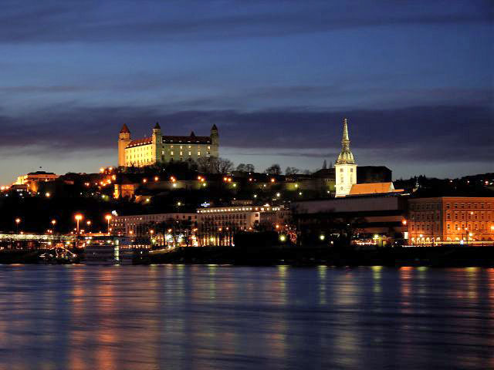
IV. Taipei Representative Office in Bratislava Economic Division

Slide 29
IV. Taipei Representative Office in Bratislava Economic Division
GENERAL TASKS
Promoting economic relations (trade, investment, technical cooperation) between TW and SR
Collection of trade-related information
Providing trade-related information to relevant companies, associations
Slovak daily news research, analysis & translation
Assistance with trade inquiries
Providing business and procurement opportunities
Meeting with Slovak executive and legislative representatives
Meeting with representatives from relevant institutions, organizations
Presentations at relevant conferences, events

Slide 30
IV. Taipei Representative Office in Bratislava Economic Division
SPECIFIC GOALS FOR 2013
Concluding the Memorandum of Understanding between TW and SR
Offer assistance to Taiwanese delegations
Participation at relevant conferences
Meetings with officials and company representatives

Slide 31
Thank you for your attention!

